Slide 1
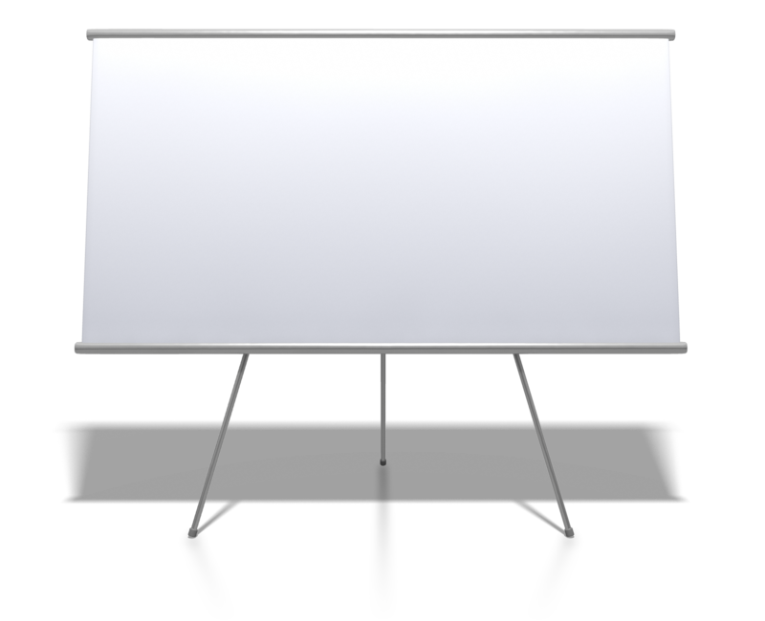
Harvard InterLock ONE
The truly Universal adhesive
©copyright by HarvardDental

Slide 2
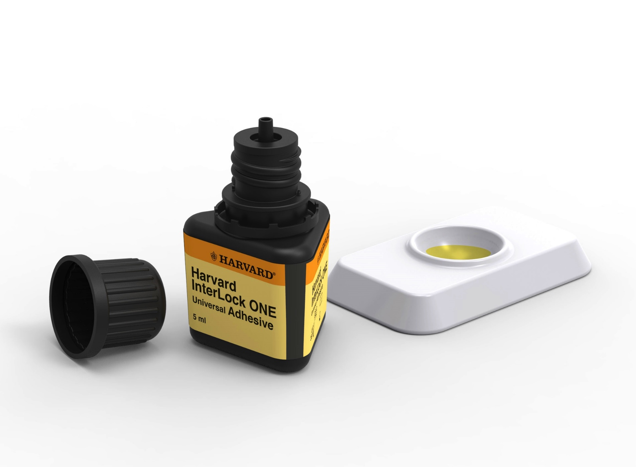
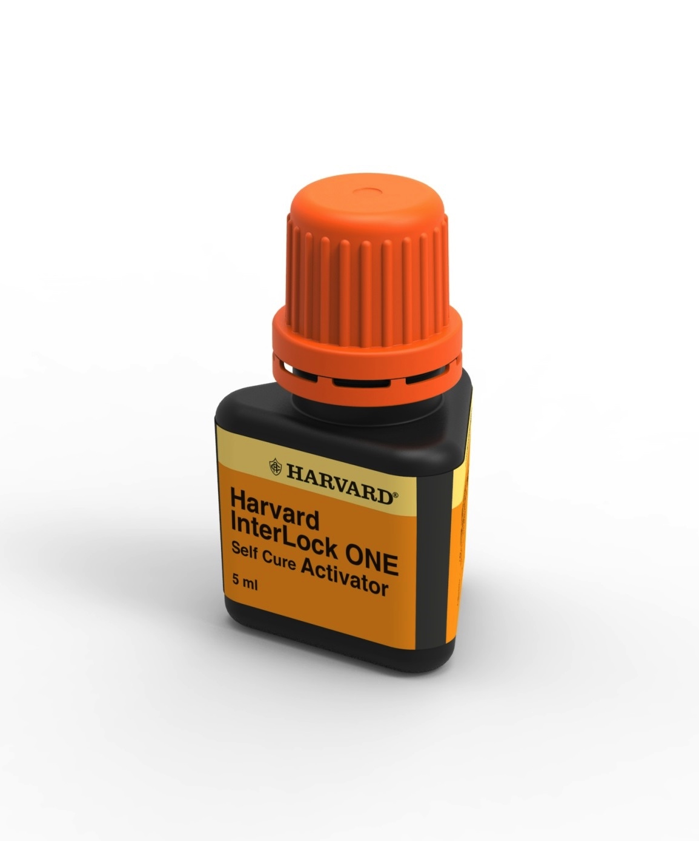
Adhesives
Harvard UltraFill.
Interlock ONE – The Great Performer
modern snap-off ampoules available
interceptor:
Thread remains clean
Bonding cures completely during demonstration
©copyright by HarvardDental

Slide 3
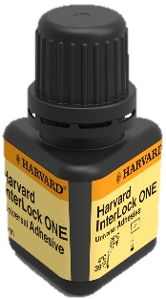
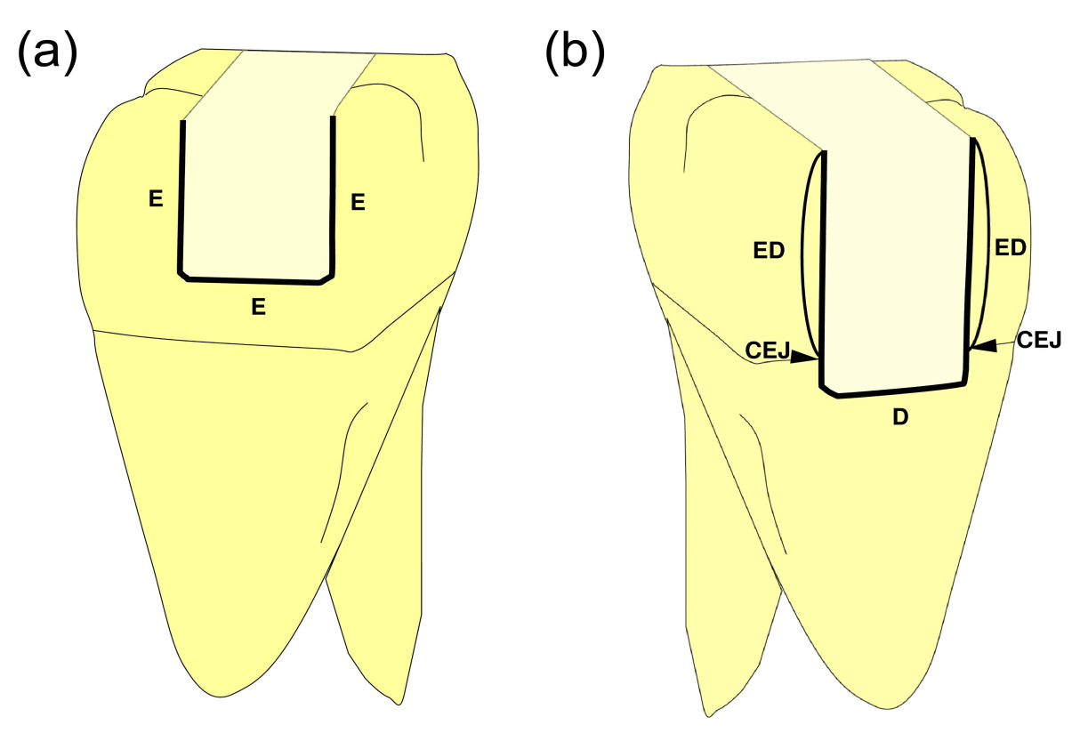
Adhesives
Harvard InterLock ONE.
Benefits of Universal Bonding Agents
Universal Bonding Agents work in every case:
On un-etched dentin
On pre-etched dentin
On un-etched enamel
On pre-etched enamel
On dry surfaces
On wet surfaces
Together with dual curing restoratives
Together with self curing restoratives (mixed with an activator)
©copyright by HarvardDental

Slide 4
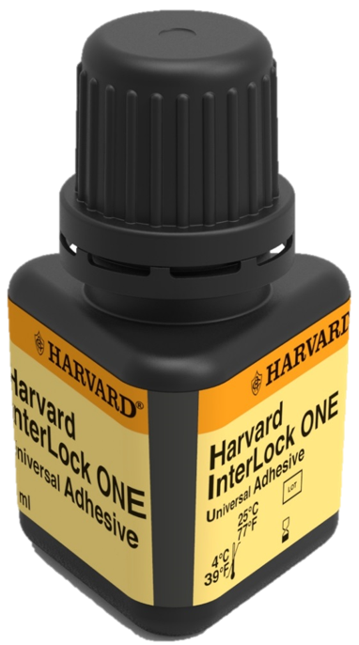
Adhesives
Harvard InterLock ONE.
Benefits of Universal Bonding Agents
Only 1 bonding agent at the chair for all „light curing“ indications
  Direct composites
  Veneer cementation
  Inlay/Onlay cementation
  Adhesive porcelain crown cementation
  Core Build-up procedures
    With self cure activator it becomes self cure, for:
      Adhesive metal crown cementation
      Post cementation in root canals
©copyright by HarvardDental

Slide 5
Adhesives
Harvard InterLock ONE.
Benefits of Universal Bonding Agents
Reduced postoperative sensitivity under self-etch conditions
  Very important for crown cementation
„Over-Etching“ is avoided. No total-etch risk on dentin Typical problem in selective etch procedures
Selective Etch performance in high risk areas
  Cementum/enamel junction; approximal axial walls
Overcomes the „how wet is wet“-problem
  Different Air-gun pressures?, how long drying time?
  Re-wetting of the hybrid layer on overdried dentin
©copyright by HarvardDental

Slide 6
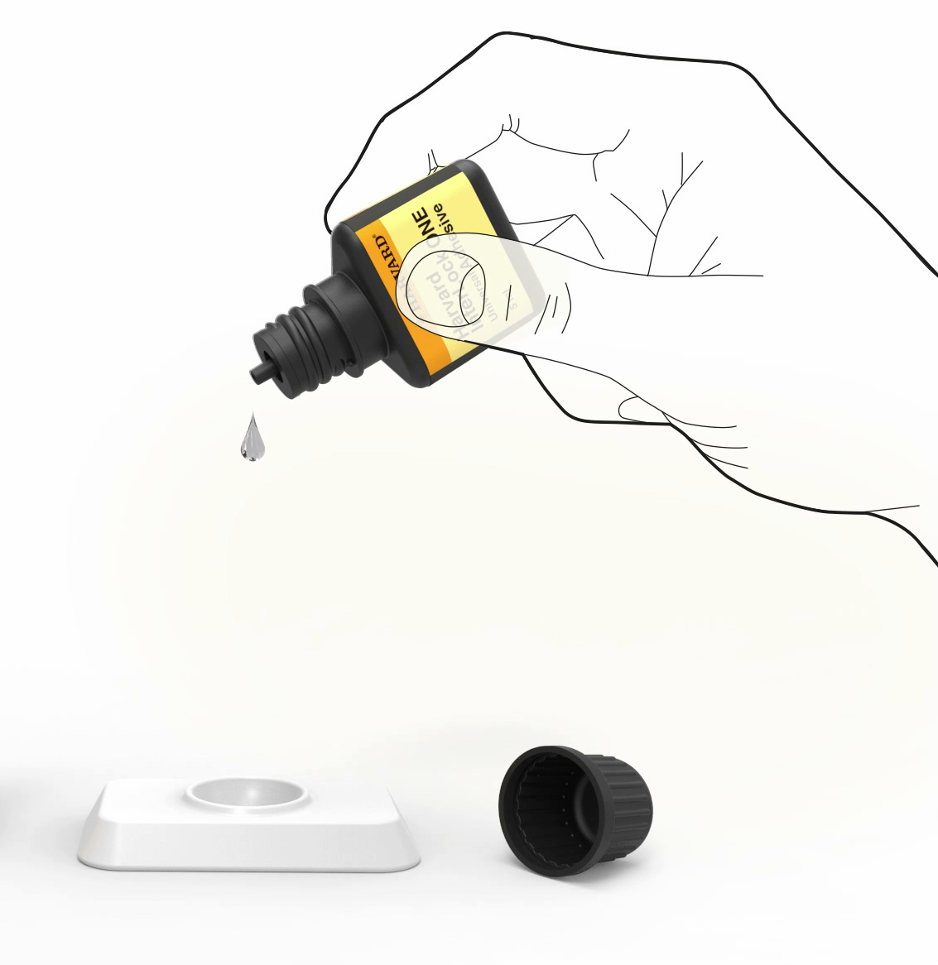
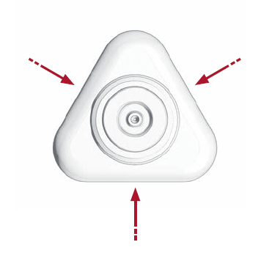

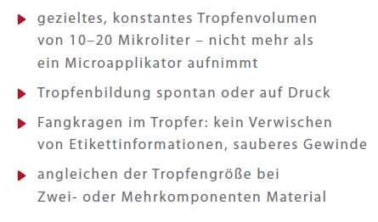
Adhesives
Harvard InterLock ONE.
Drop-Control
Safe and controlled drop shapes
Constant drop volume of 10-20 microliter – exact amount that a brush can take on
Interceptor in the dripper: liquid runs back into the bottle
Always clean label information, clean bottle
Equalling of the drop size with 2- or more component materials
260 drops = 260 applications
©copyright by HarvardDental

Slide 7
Adhesives
Harvard InterLock One.
Shearbond strength on Dentin + Enamel
After Thermocycling :
Subjected to 2,000 thermocycles between 5° and 55° C with a dwell time of 30 s.
= stress test simulation of wear for ca.1 year
©copyright by HarvardDental
7
Notes:
Self etching tissues with bonding agent, light cured composite

Slide 8
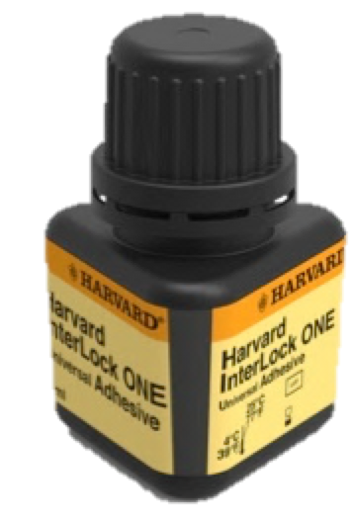
Adhesives
Harvard InterLock One.
Self-Etch with composite self-cured
Self-etch shearbond strength
Dentin & enamel after thermocycling, Adhesive light cured & composite self cured
InterLock ONE
Dentsply
Prime&Bond Active
3MEspe
Scotchbond Universal
KaVoKerr
Optibond All-In-One
Dentin
Enamel
Dentin
Enamel
Dentin
Enamel
Dentin
Enamel
©copyright by HarvardDental
= stress test simulation of wear for ca.1 year - Subjected to 2,000 thermocycles between 5° and 55° C with a dwell time of 30 s.
8
Notes:
Self etching tissues with bonding agent, self cured composite; for instance core build up material

Slide 9
Adhesives
Harvard InterLock One.
Selective etch on enamel
Dentin & enamel after thermocycling, Adhesive: Light cured
Etching: Total Etch or self etch; Composite: Light cured or self cured
InterLock ONE
Dentsply
Prime&Bond Active
3MEspe
Scotchbond Universal
KaVoKerr
Optibond All-In-One
Dentin
Enamel
Dentin
Enamel
Dentin
Enamel
Enamel
Dentin
©copyright by HarvardDental
= stress test simulation of wear for ca.1 year - Subjected to 2,000 thermocycles between 5° and 55° C with a dwell time of 30 s.
9
Notes:
Self etching tissues with bonding agent, self cured composite; for instance core build up material

Slide 10
Adhesives
Harvard InterLock One.
SELF-etch shearbond strength
Dentin & enamel after thermocycling, Adhesive light cured & composite light cured
InterLock ONE
Dentsply
Prime&Bond Active
3MEspe
Scotchbond Universal
KaVoKerr
Optibond All-In-One
Dentin
Enamel
Dentin
Enamel
Dentin
Enamel
Dentin
Enamel
= stress test simulation of wear for ca.1 year - Subjected to 2,000 thermocycles between 5° and 55° C with a dwell time of 30 s.
©copyright by HarvardDental
10
Notes:
Total etching tissues with phosphoric acid, conditioning with bonding agent, light cured composite

Slide 11
Adhesives
Harvard InterLock One.
Total Etch with composite light cured
Total-etch shearbond strength
Dentin & enamel after thermocycling, Adhesive light cured & composite light cured
InterLock ONE
Dentsply
Prime&Bond Active
3MEspe
Scotchbond Universal
KaVoKerr
Optibond All-In-One
Enamel
Dentin
Enamel
Dentin
Enamel
Dentin
Enamel
Dentin
Enamel
= stress test simulation of wear for ca.1 year - Subjected to 2,000 thermocycles between 5° and 55° C with a dwell time of 30 s.
©copyright by HarvardDental
11
Notes:
Total etching tissues with phosphoric acid, conditioning with bonding agent, light cured composite

Slide 12
Adhesives
Harvard InterLock One.
Total Etch with composite self cured
Total-etch shearbond strength
Dentin & enamel after thermocycling, Adhesive light cured & composite self cured
InterLock ONE
Dentsply
Prime&Bond Active
3MEspe
Scotchbond Universal
KaVoKerr
Optibond All-In-One
Enamel
Dentin
Dentin
Enamel
Dentin
Dentin
Enamel
Enamel
©copyright by HarvardDental
= stress test simulation of wear for ca.1 year - Subjected to 2,000 thermocycles between 5° and 55° C with a dwell time of 30 s.
12
Notes:
Total etching tissues with phosphoric acid, conditioning with bonding agent, self cured composite; root canal post bonding, metal crown cementation

Slide 13
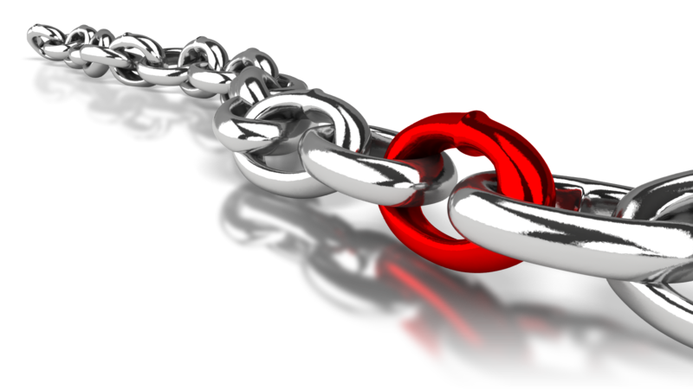
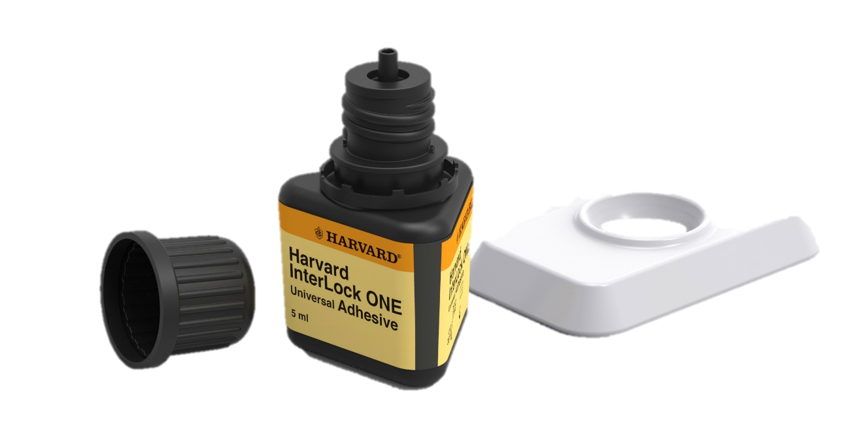
Adhesives
– State of the art
Harvard InterLock One.
really Universal Adhesive
allows for bonding of ceramic, zirconia metal crowns with composite cements
very high bond strength after stress test→ long-term stability
extremely good marginal behaviour
contains MDP
pH-value: 2,5
solving agent: Ethanol (pleasant smell)
always constant drop size
content: 260 drops= good calculation in the dental office
MDP
©copyright by HarvardDental
Notes:
MDP = Methacryloyloxy Decyl (Dihydrogen) Phosphat

Slide 14
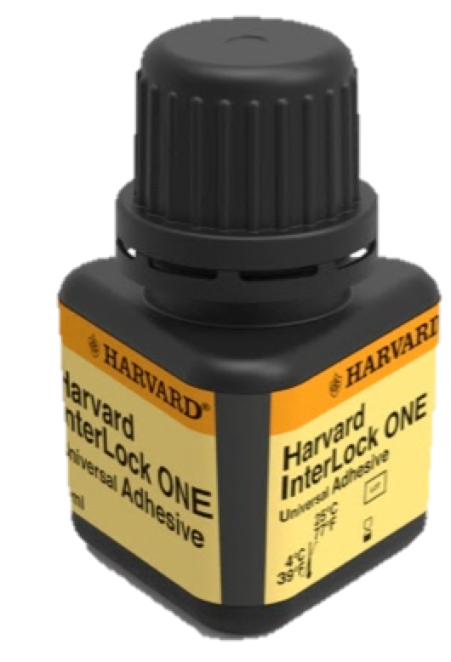
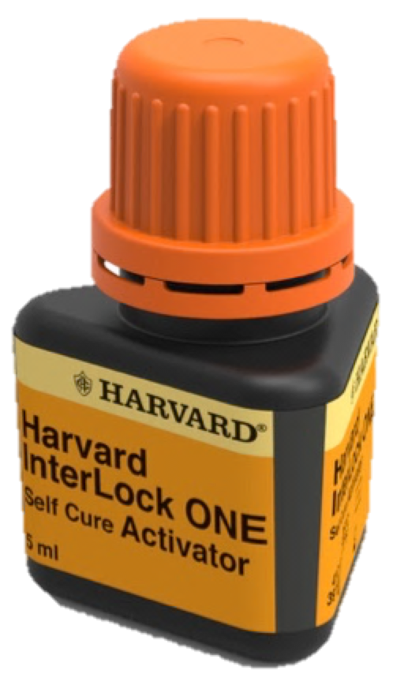
Adhesives
HARVARD InterLock ONE
One of the best bonding agents on the market
Special Combi Kits with PremiumFill+ and UltraFill
With Light
HARVARD InterLock Self-Cure Activator
For self-curing cases:
InterLock One + Self Cure Activator
For all indications
For root post cementations
For metal crown fixation
Without light
&
Mae West
Success is a 2-bladed golden sword!

